Slide 1
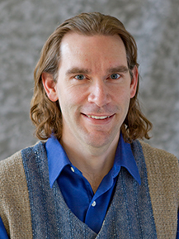
From Mined Data To Useful Predictions
A Predictive Analytics Demo
Martin Madsen
Ph.D. in Experimental Physics
16 years’ experience working with sensors, data collection, data analysis, and predictive model building

Slide 2
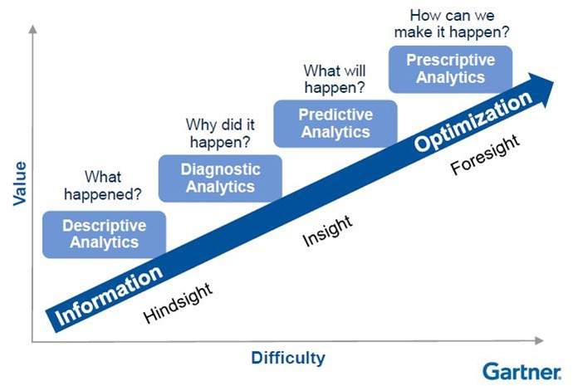

Slide 3
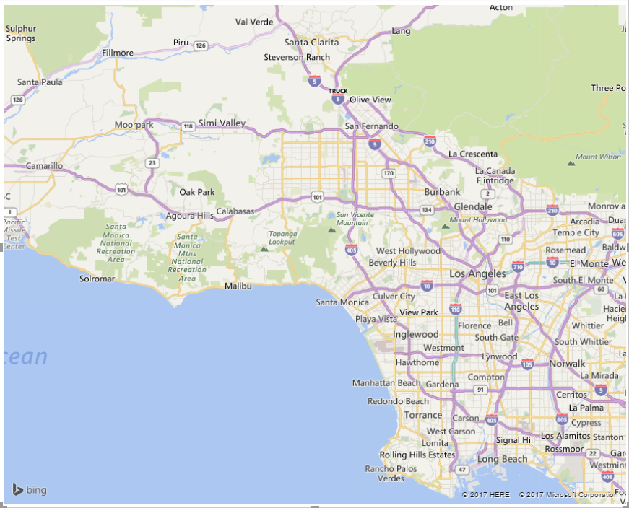
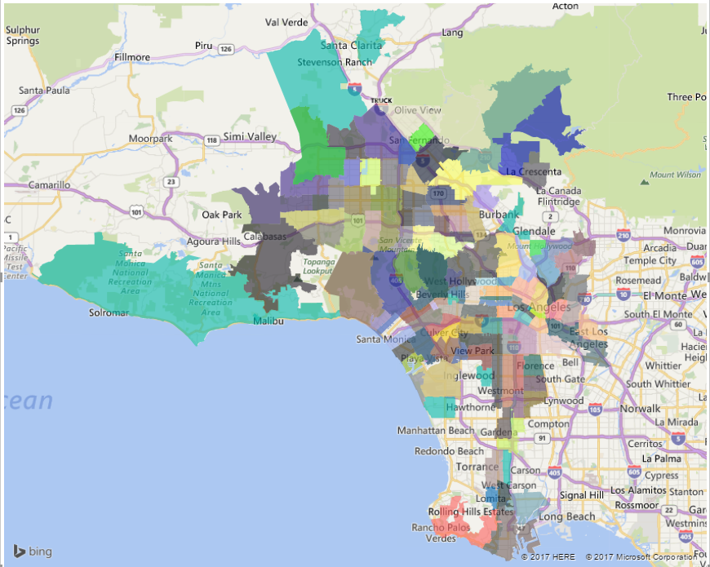
City of Los Angeles, California
Water Use (HCF) Power Use (kWh)
134 Zip Codes
from
July, 2005 to June, 2013
data.lacity.org/A-Livable-and-Sustainable-City/
Water-and-Electric-Usage-from-2005-2013/asvq-scwp

Slide 4
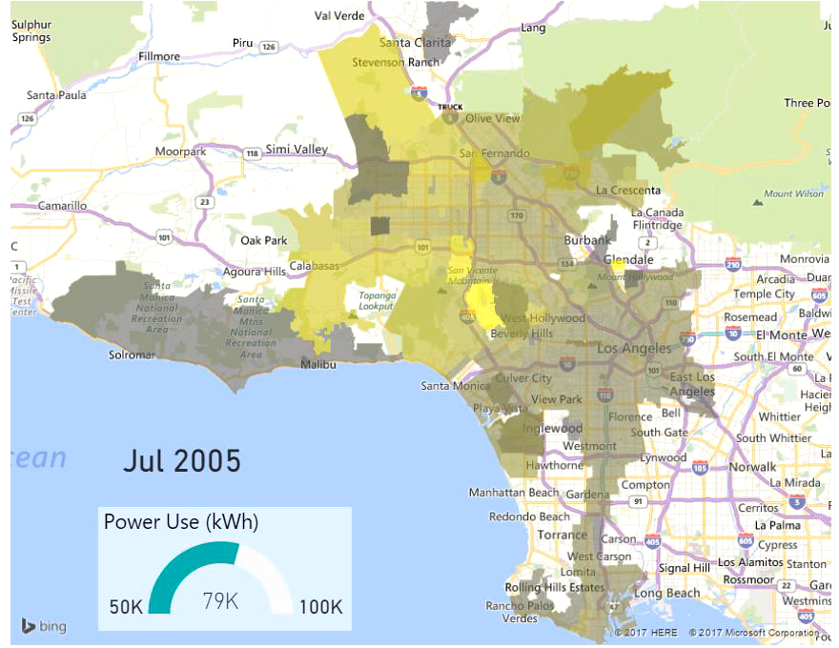
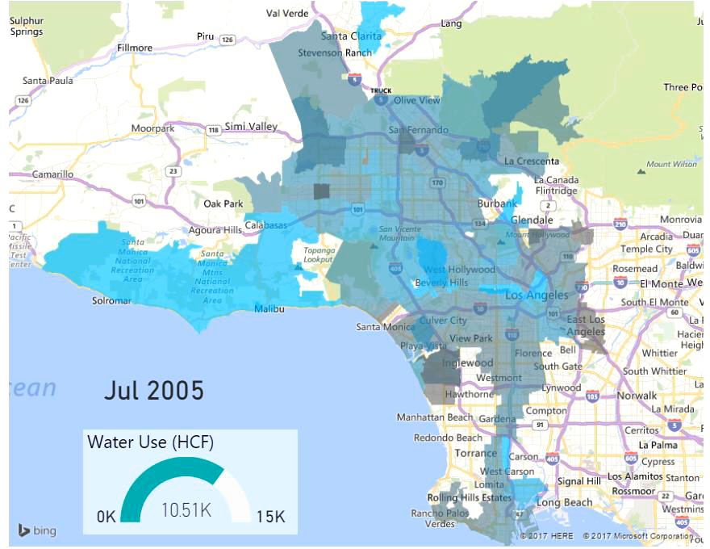
Descriptive Analytics

Slide 5
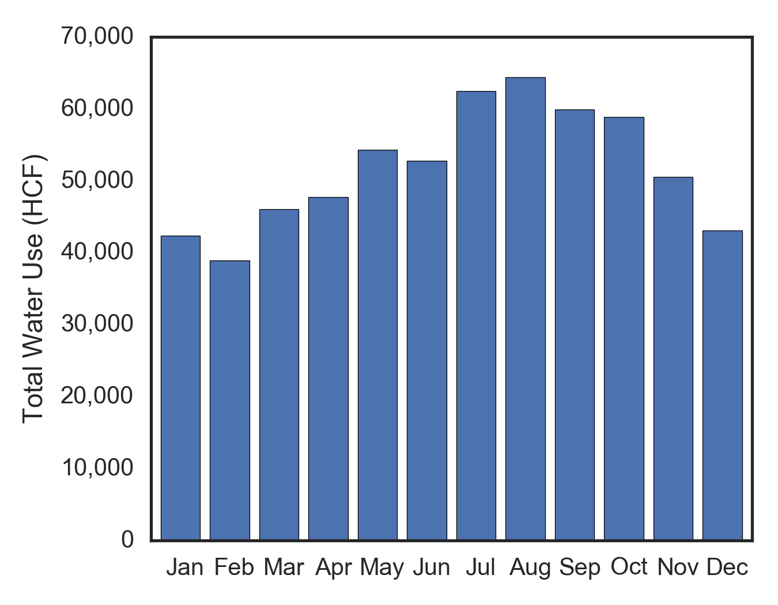
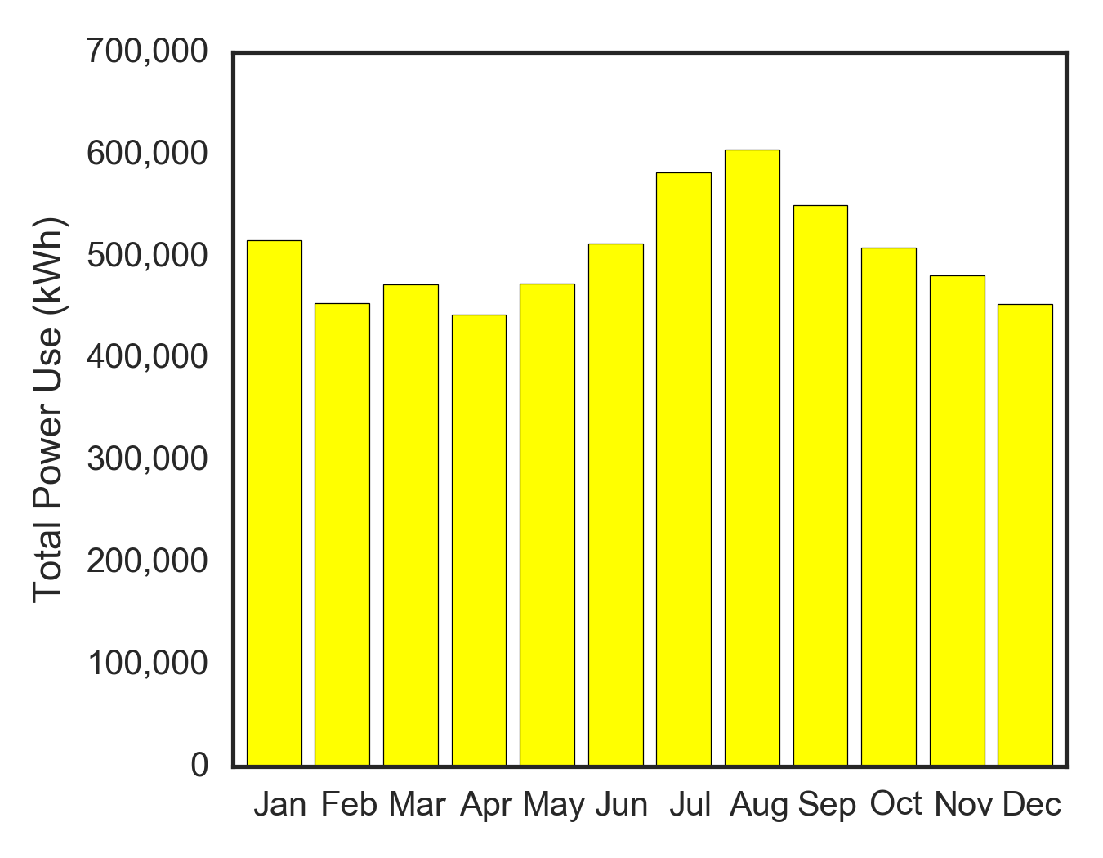
Diagnostic Analytics
Summer
Irrigation
Winter
Heating
Summer
Cooling

Slide 6
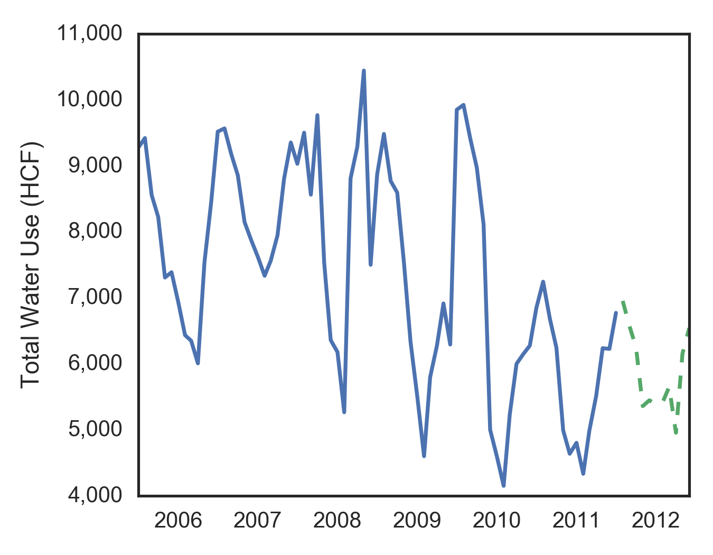
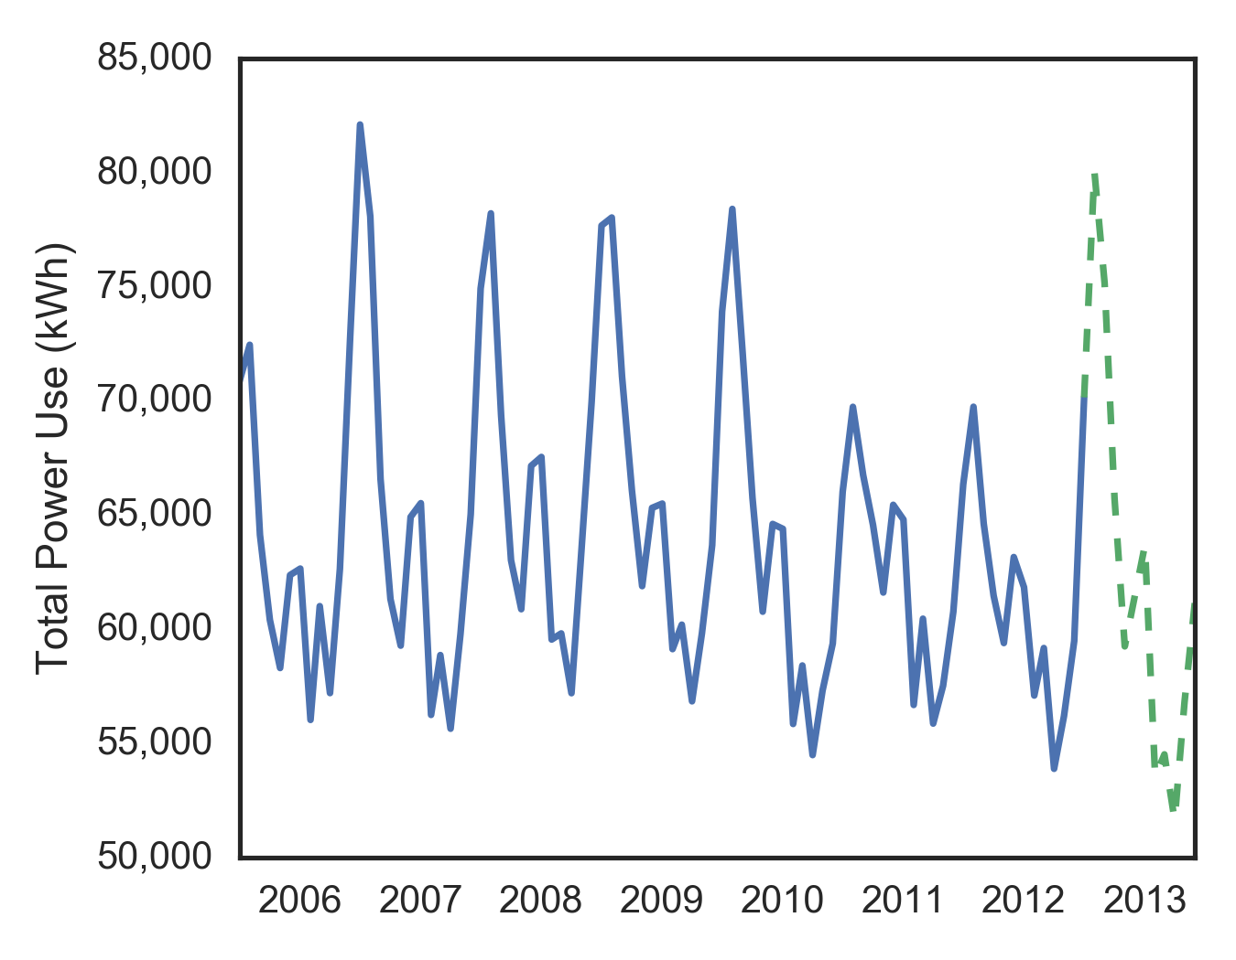
Predictive Analytics

Slide 7



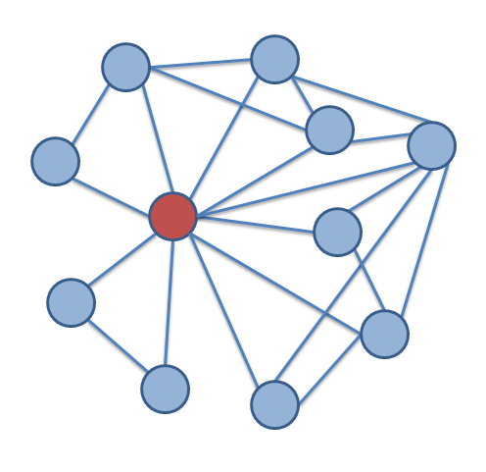
Over Predict
Supplier
Customers
Waste $
Income Lost $
Under Predict
Over Predict
Waste $
Distribution $
Under Predict
Location Network

Slide 8
“Use Last Year’s Number” Model

Slide 9
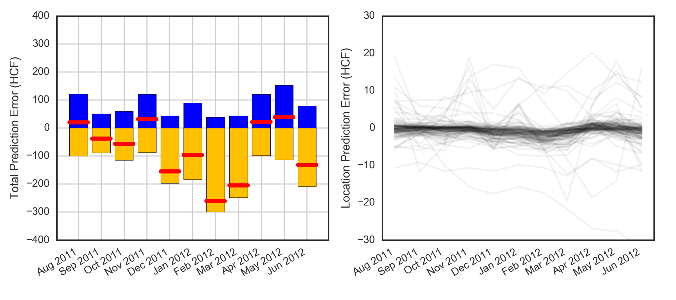
“Use Last Year’s Number” Model for Water Use
Total Local Prediction Error
2,660 HCF (6%)
Net Prediction Errors
Total Error for 11 months: -826 HCF on volume of 42,590 HCF (2%)

Slide 10
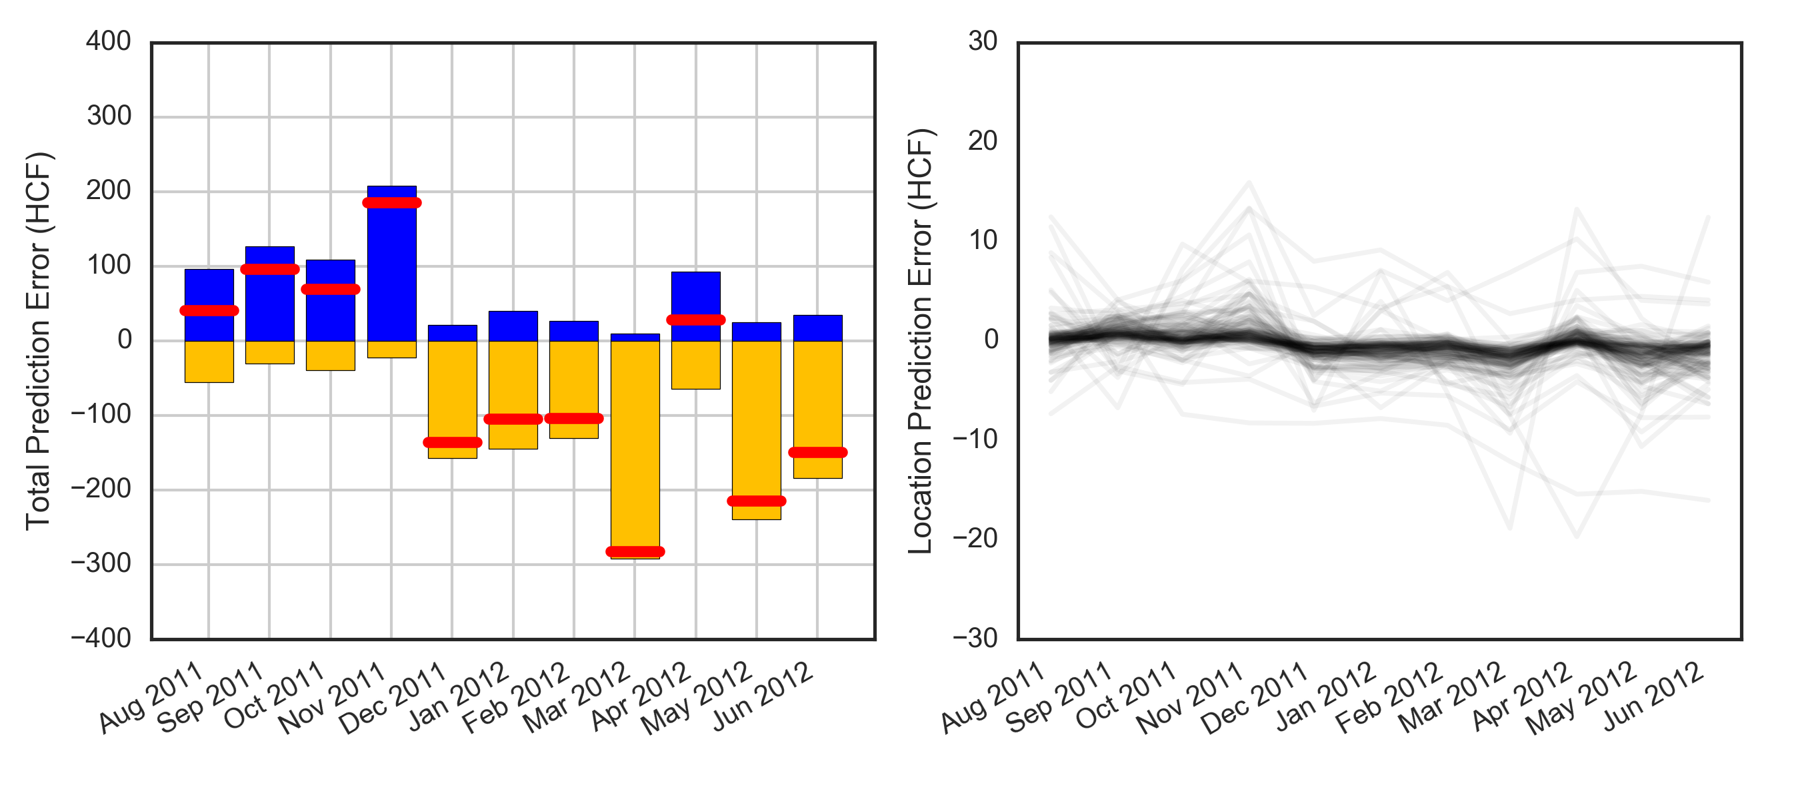
Linear Model
Total Local Prediction Error
2,161 HCF (5%)
Net Prediction Errors
Total Error for 11 months: -569 HCF on volume of 42,590 HCF (1.3%)

Slide 11



Data Enriched Model

Slide 12
Linear Model
Total Local Prediction Error
2,161 HCF (5%)
Net Prediction Errors
Total Error for 11 months: -569 HCF on volume of 42,590 HCF (1.3%)

Slide 13
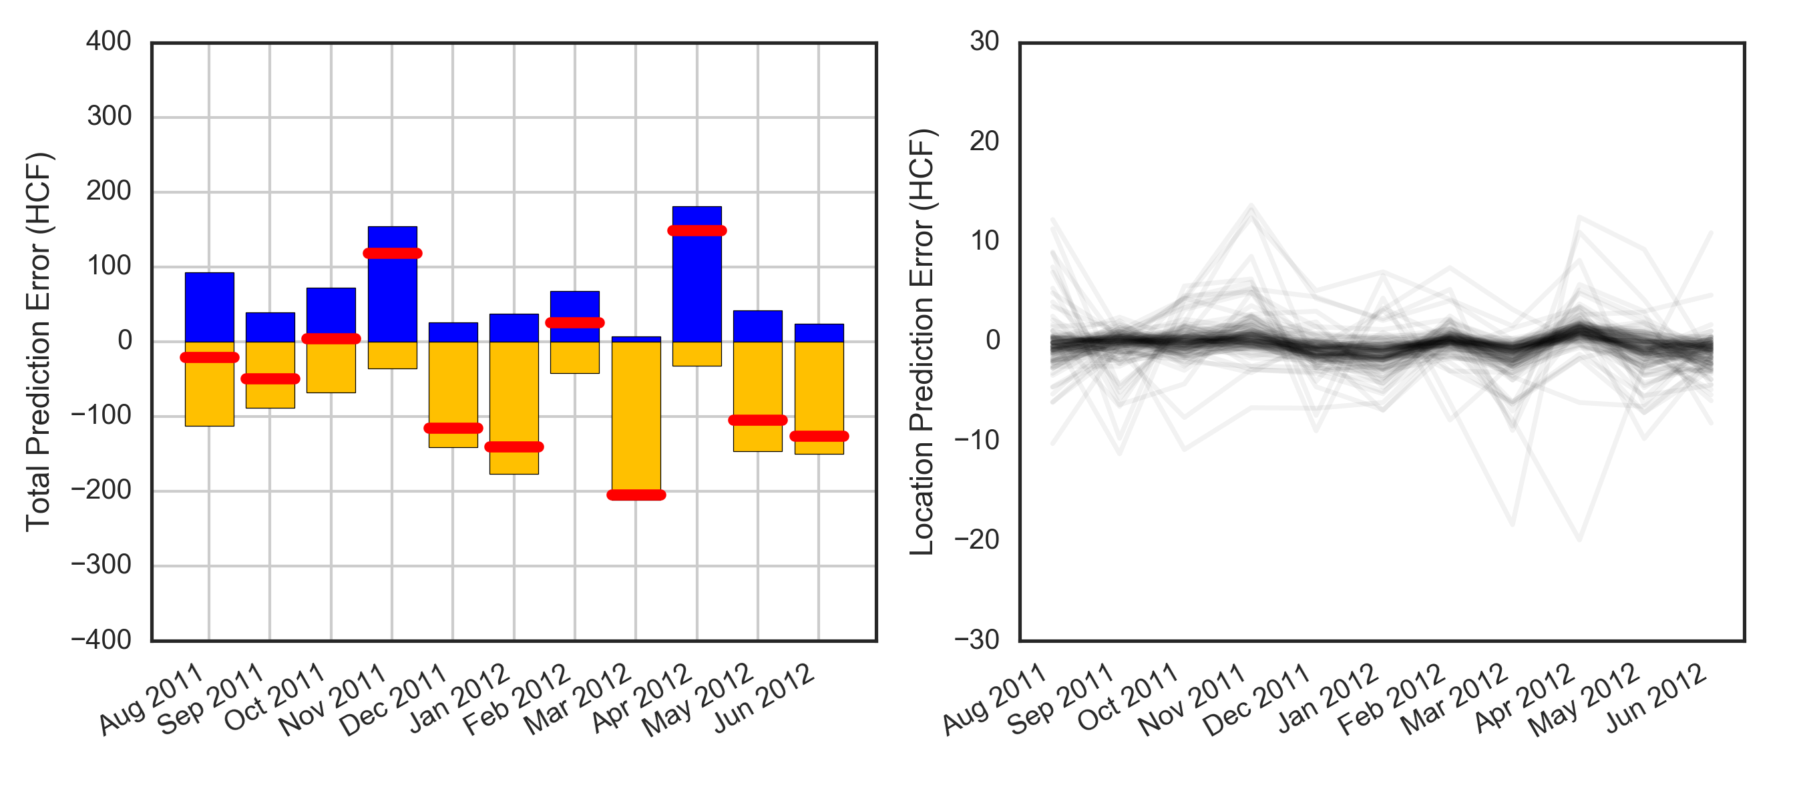
Adaptive XGBoost Data Enriched Model
Total Local Prediction Error
1,951 HCF (4.6%)
Net Prediction Errors
Total Error for 11 months: -462 HCF on volume of 42,590 HCF (1.1%)

Slide 14

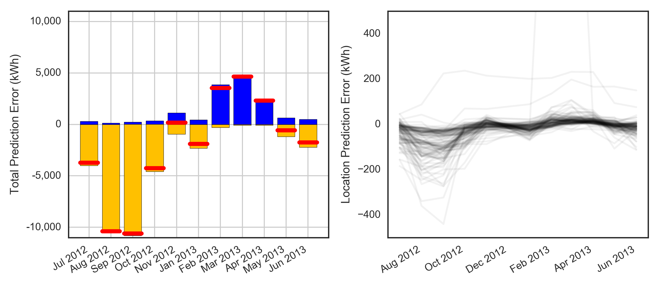
“Last Year” Model for Power Use
Total Local Prediction Error
51,800 kWh (7.5%)
Net Prediction Errors
Total Error for 11 months: -22,370 kWh on volume of 687,476 kWh (3.3%)

Slide 15
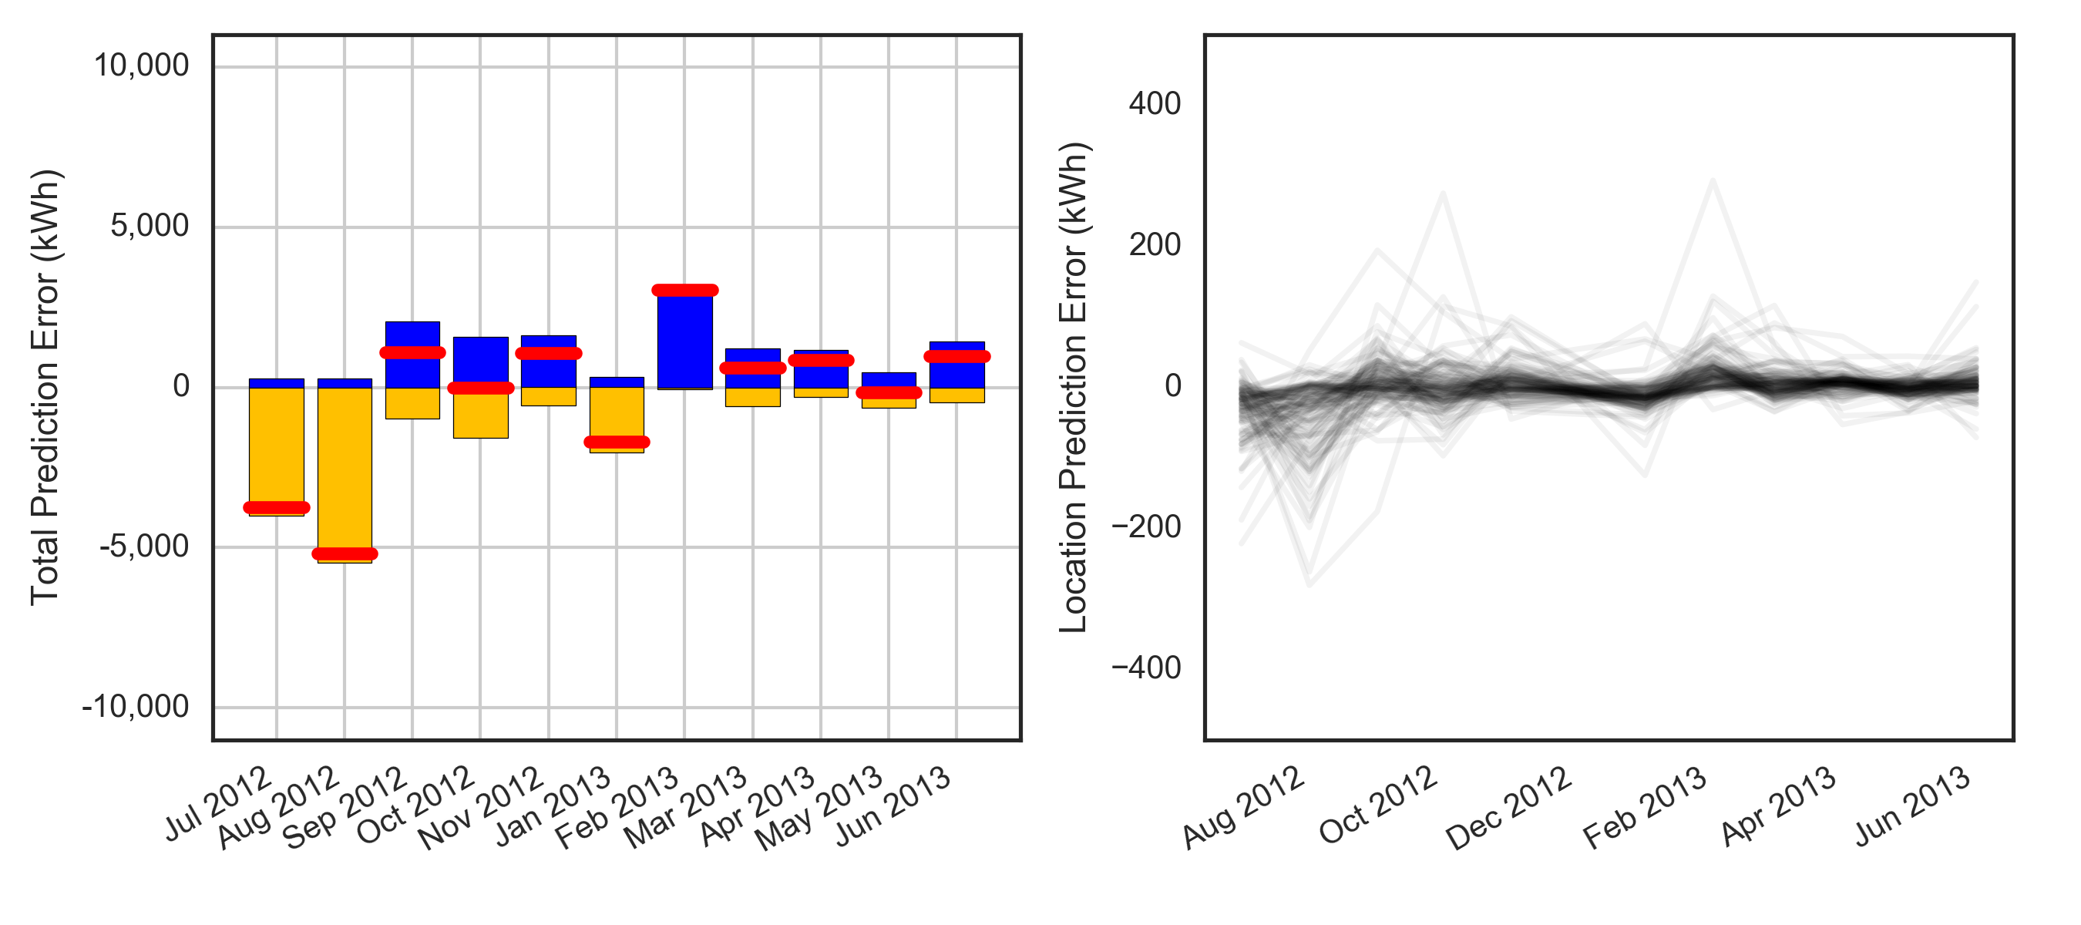
Adaptive XGBoost Data Enriched Model
Total Local Prediction Error
30,200 kWh (4.4%)
Net Prediction Errors
Total Error for 11 months: -3,153 kWh on volume of 687,476 kWh (0.5%)

Slide 16
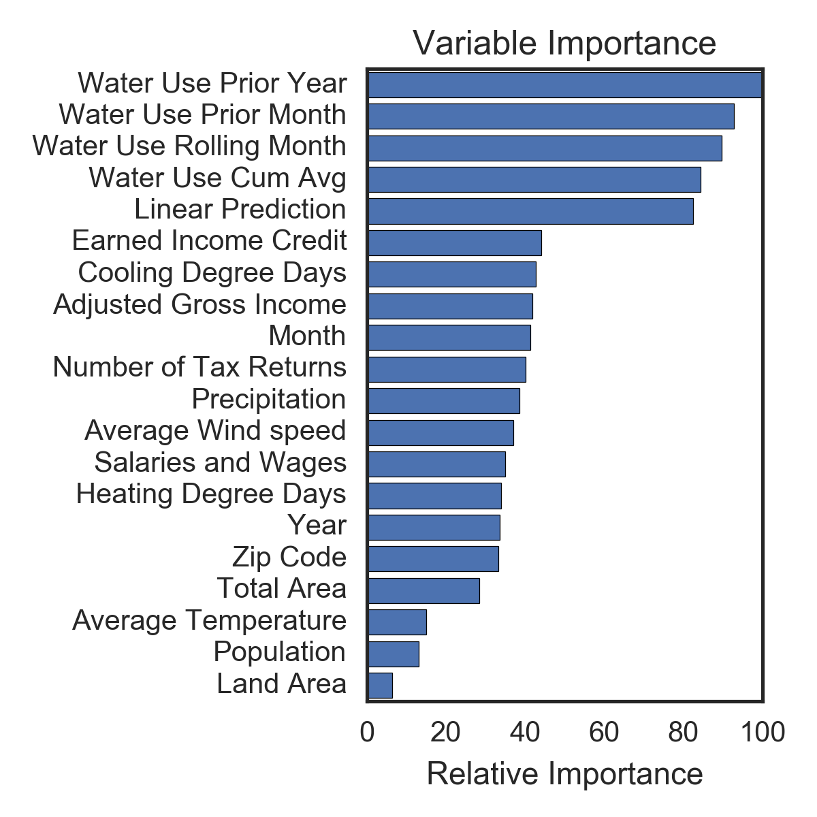
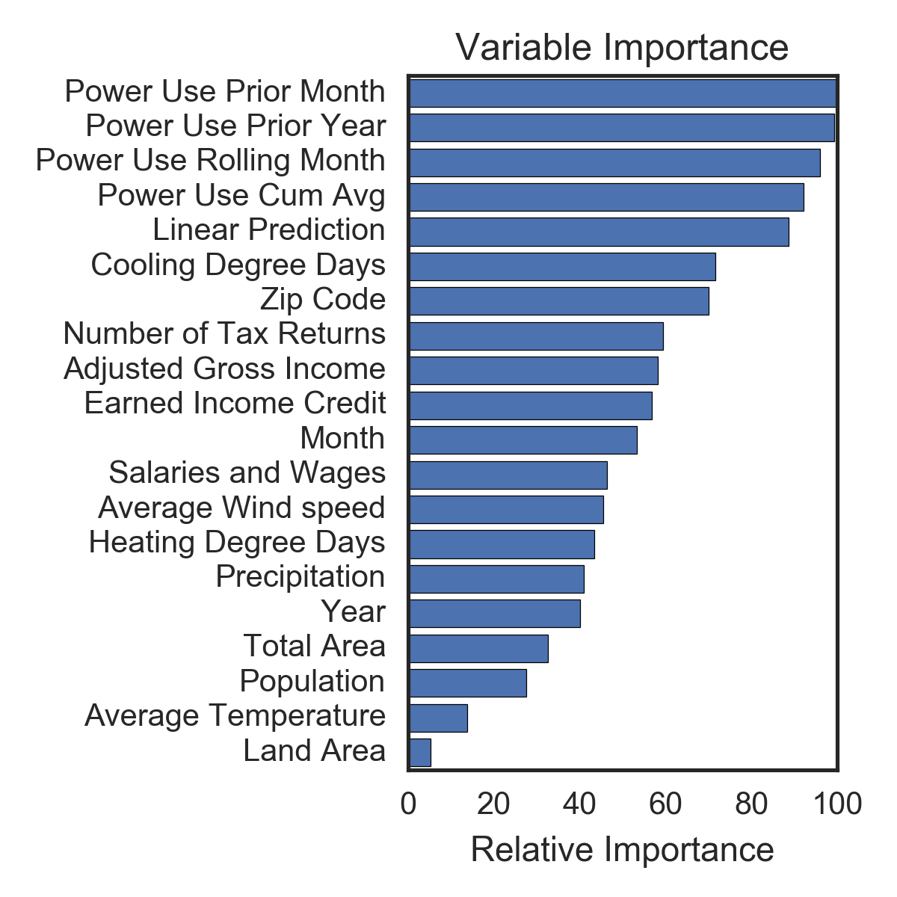
BONUS: Diagnostic Analytics

Slide 17
 | “Last Year” Model | Machine Learning Model |  | Improvement
Total Net Error | -826 HCF | -462 HCF |  | 45%
Absolute Local Error | 2,660 HCF | 1,951 HCF |  | 26%
 | “Last Year” Model | Machine Learning Model |  | Improvement
Total Net Error | -22,370 kWh | -3,153 kWh |  | 86%
Absolute Local Error | 51,800 kWh | 30,200 kWh |  | 42%

Slide 18
Thank You!
Questions, comments, or further conversation:
Martin John Madsen
https://www.linkedin.com/in/martinjohnmadsen
Notes:
[Josh’s Slide]

